Slide 1



Slide 2
DeVoe’s Chair
Supervisor’s name: Dr. Susant Kumar Panigrahi
Team Members:
18BCE10074 - Ayushi Jaimani
18BCG10022 - Anutej Kardele
18BEC10007 - Anjali Prajapati
18BEC10037 - Khushi Rathore
18BEC10084 - Sushant Sharma
18BEC10088 - Utkarsh Gupta
18BCE10247 - Shikhar Srivastava

Slide 3
OBJECTIVE
This project is based on IOT(Internet of Things). IOT allows object to be sensed and controlled remotely across existing network infrastructure,creating opportunities for more accuracy and improving efficiency.
DeVoe’s Chair is a smart wheelchair which comes with a fall detection system,GPS tracking,sensing your body temperature,heart rate,intelligent picking along with a home automation system which can be controlled by google assistant or touch screen.This chair is the future of care services around the globe, be it daycare for children or old age homes for elderly people.The chair provides comfort and security to anyone who is in a need to carry out the basic day to day life activities. Their family members can keep an eye on whether or not the elderly are properly treated, parents can keep a watch over the location and activities of their children in daycares, or special schools.

Slide 4
Existing Projects
There’s been a project which is being made with a similar concept. In that project, a fall detection device was made which senses the jerk and alerts the relatives and loved ones of the user through Wifi.
Intelligent picking is done by bluetooth modules and tensorflow.
Home automation systems are made with NODE-MCU(ESP8266) or raspberry pi.This project provides home automation only with wifi.
In our project we are adding multiple modules.Firstly we are using ESP32 ; it has wifi as well as bluetooth modules.We are using tof camera in our intelligent picking instead of tensorflow.
We are trying to use low cost components and adding different modules to the chair.

Slide 5
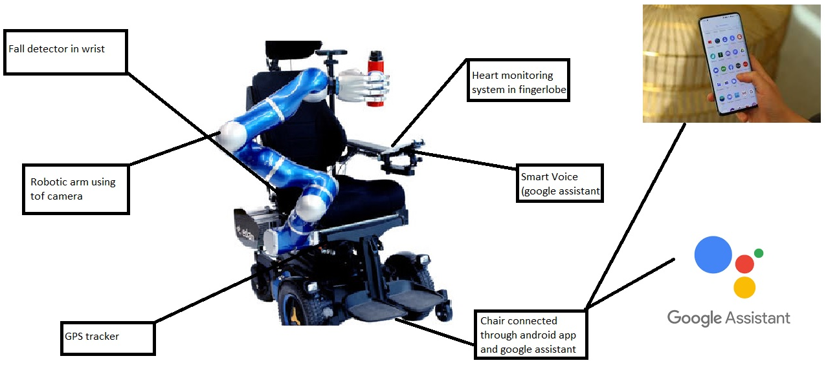
Block diagram of the chair

Slide 6
Home Automation System
Purpose:
Smart Home Systems is a concept in which all the electrical appliances or the devices are controlled using a single remote control(mobile application).
We are going to connect some of the home’s electrical appliances to the Relay module and control it through ESP32 Microcontroller. We will make a firebase realtime database and connect it from the android app and google assistant.The best part is that you can have full control over the switching of your appliances from anywhere in the world.Home Automation systems that are already available in the market are very costly. We can use an ESP32 board to connect different home appliances and control them using an Android App. This will be very low in cost and an efficient way to automate the house.

Slide 7
Components Required:
ESP32
Relay Module
Breadboard
Connecting Wires
ESP32:- It is a low-power and low-cost microcontroller board which has a built-in WiFi and a dual-mode Bluetooth module. This Microcontroller board is created and developed by Espressif Systems. This board has built-in power amplifiers, low nice receive amplifiers, filters, and antenna switches.
RELAY:- It acts likes an toggle switch(opening and closing .It is connected between the wifi module and electrical appliances.It controls high voltages(220 volt) using very low voltage as input.Basically it protects digital control system and isolates it from the analog signals.

Slide 8
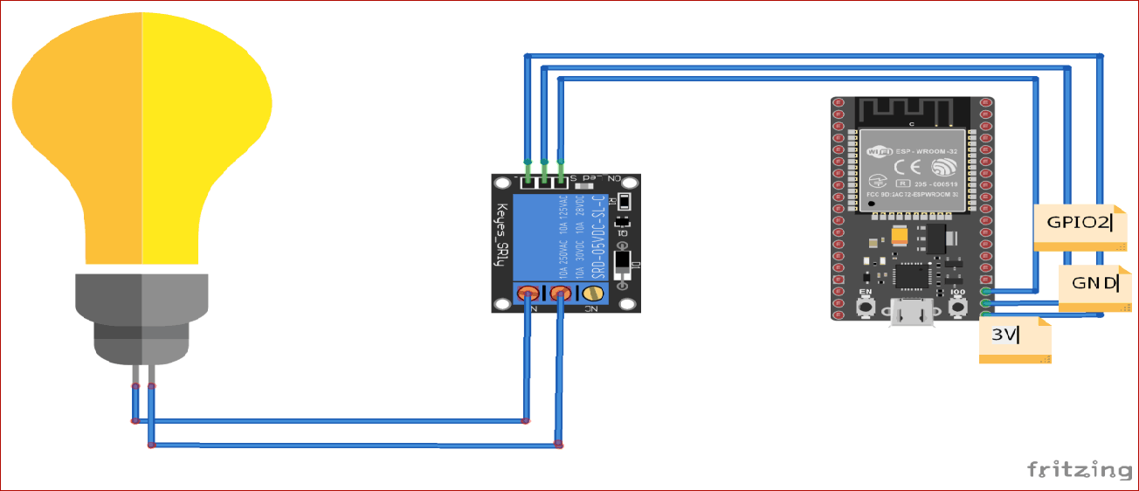
Circuit Diagram

Slide 9
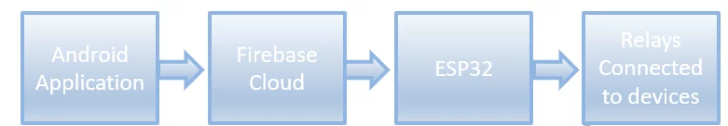
BLOCK DIAGRAM:

Slide 10
Association
In the above block diagram, the flow of this project is shown. The relays are connected to the home’s electrical appliances or devices. A mobile application will send an On or OFF command to the database. This cloud is connected to the ESP32 microcontroller board through WiFi. To Switch the electronic device on, we will send a “1” in the database and to switch it off we will send a “0” in the database. This command will then be fetched by the microcontroller because it is also connected to the database. Based on this 0 or 1, the microcontroller will switch the relay module on or off which will ultimately result in the switching of the electrical appliances.

Slide 11
Fall Detection System
Purpose:
When it comes to old age or handicapped, it becomes necessary to monitor them.Due to weakness and weak joints they have a great risk of falling down. Now it is important to know if a person has fallen so that he/she can be helped on time.For this purpose we propose a smart fall detection system. The system uses accelerometer and gyro sensor to detect person movements, It can be mounted on persons hand or wheelchair for detection.

Slide 12
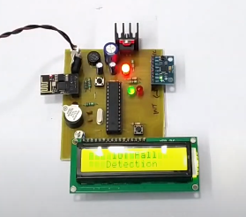
Components Required
PCB and Breadboard
Accelerometer Sensor
Gyroscope Sensor
Node MCU (ESP8266)
LCD Display
Crystal Oscillator
LED’s
Transformer
Resistors
Capacitors
Diodes
Push Buttons
IC
Software Used:
Arduino IDE
MC Programming Language: C
IOTGecko

Slide 13
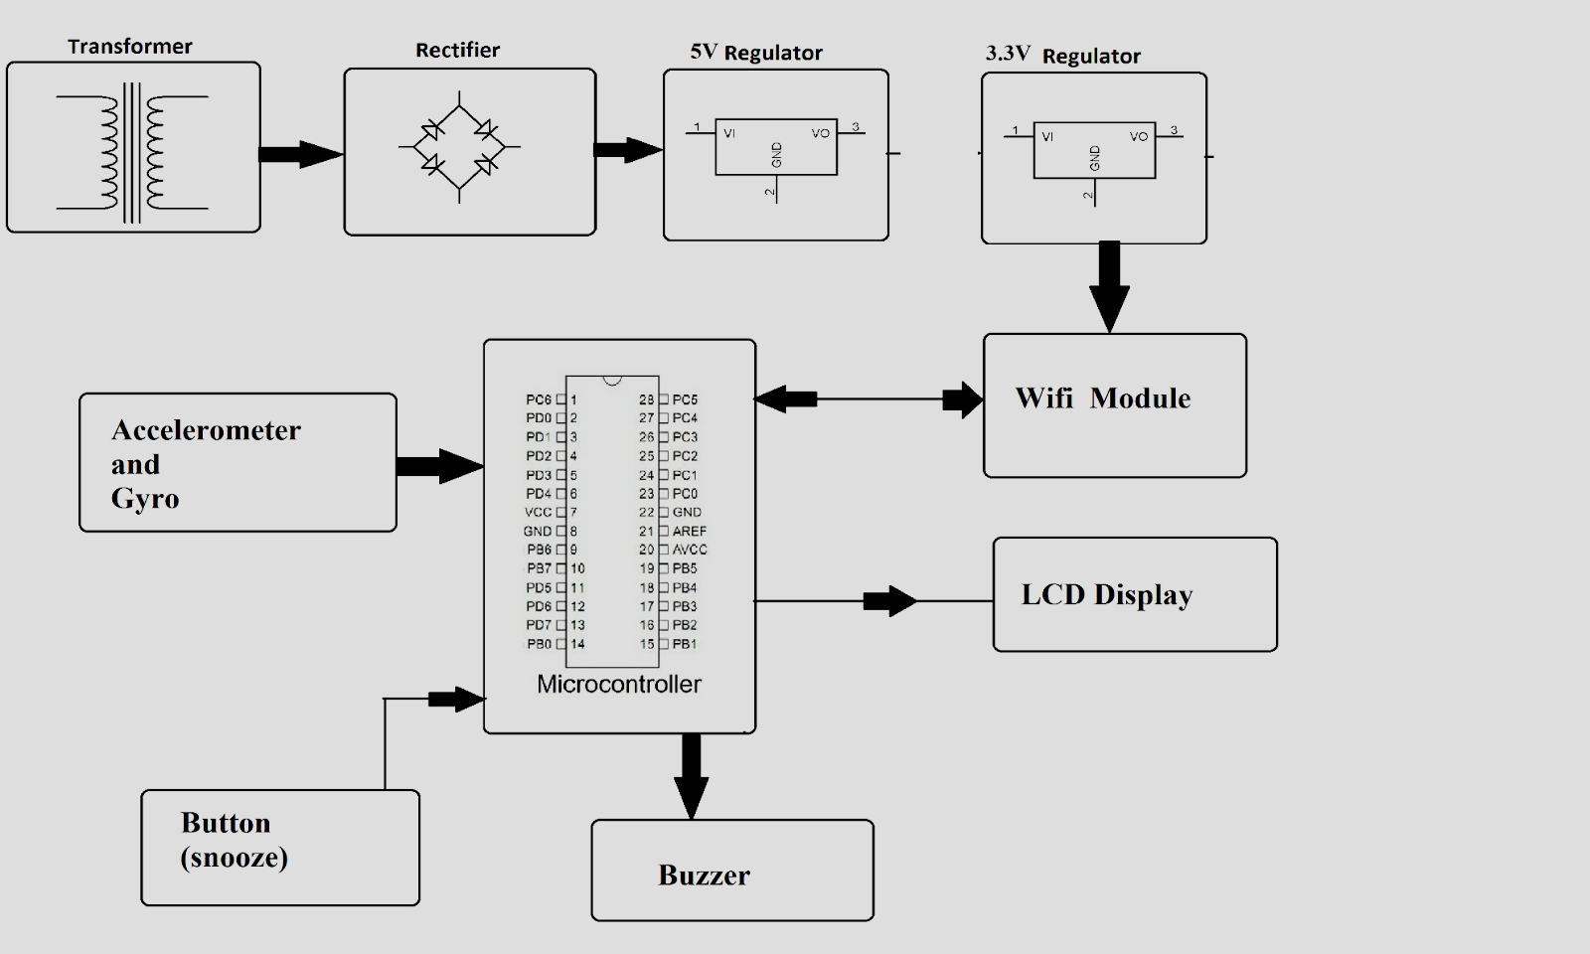
Block Diagram

Slide 14
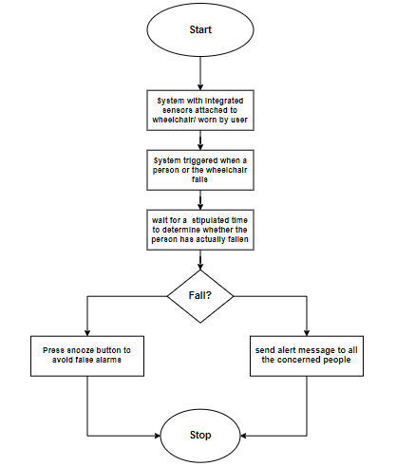
Flowchart:

Slide 15
Association
The sensor is connected to a microcontroller in order to constantly transmit the acceleration data.
The system keeps monitoring for fall detection and abrupt movement changes in person.
A sudden abrupt change with jerk in the system is treated as a fall.
If in case the person did not fall and alarm was false, the system allows to snooze the alert if person presses snooze button in 5 seconds.
If person does not press the snooze, system detects person has fallen and automatically triggers alert through wifi connection to alert the loved ones of the person about the situation instantly.

Slide 16
GPS Tracking System
Purpose:
The GPS concept is based on time and the known position of GPS specialized satellites.
The satellites carry very stable atomic clocks that are synchronized with one another and with the ground clocks.
The satellite locations are known with great precision.
We have connected a GPS tracking system to the Wheelchair in order to get the exact location of chair, if the user’s caretaker/concerned people want to and in case of fall too.

Slide 17
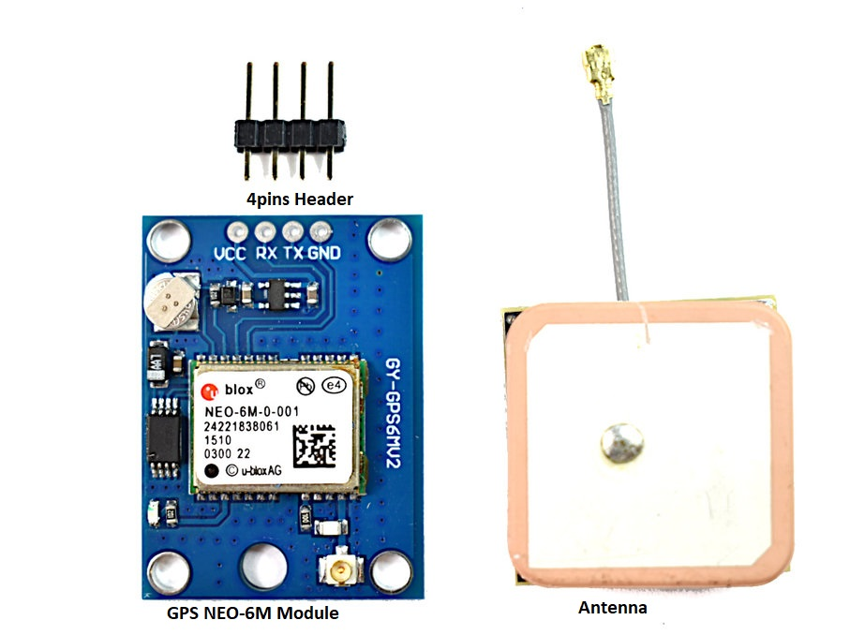
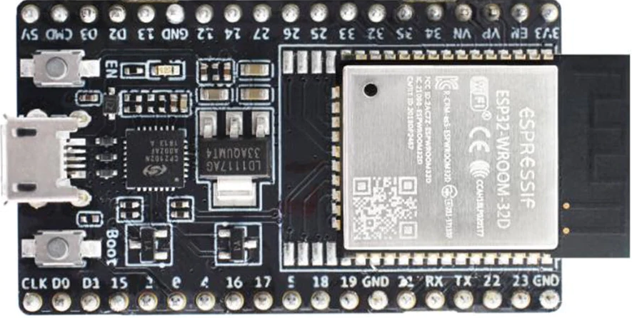
Components Required
NEO-6M GPS module
ESP32 development board.
Breadboard
Jumper wires
Arduino IDE software.
Micro USB cable

Slide 18
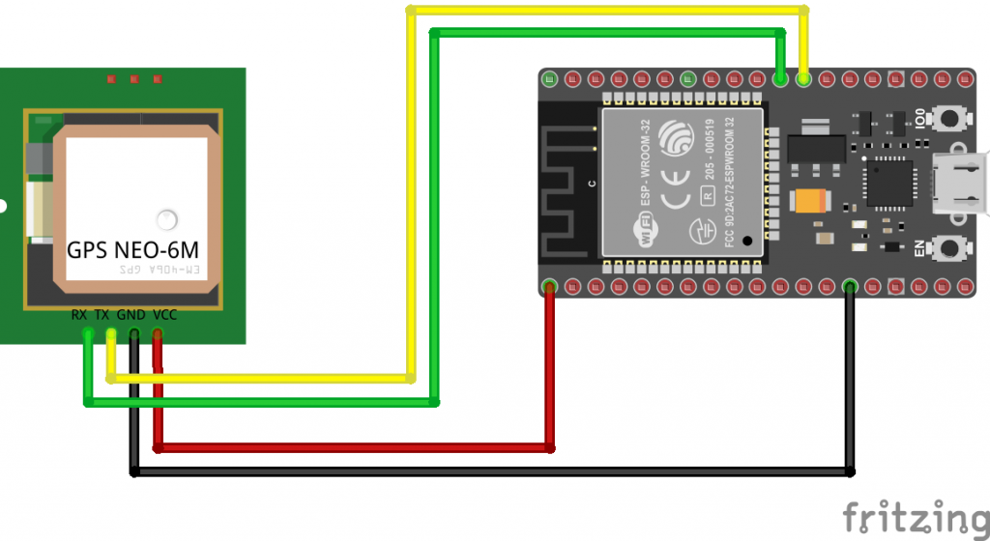
Circuit Diagram

Slide 19
Association
It will provide the exact location of wheelchair to the concerned people through wifi whenever those people want to see or if any fall occurs in the following order:
Whenever there will be any fall, due to the jerk produced, the fall detection system sends an alert message to the people connected to the user through the wheelchair.
And then, our GPS module will come to work. It will send the exact location of the wheelchair through the Mobile app which will be connected to all the systems of our project.
So in this way the other people will get alerted about the fall and will get the information about the current location of the wheelchair

Slide 20
Measuring the body temperature and heart rate
Purpose:
Our device puts forward a smart patient health tracking system using Web Server so that the Patient health parameters like Heart Rate and Blood Oxygen level along with body temperature can be monitored. User interface will be the android app and google assistant.

Slide 21
Components required:
Esp32
Jumper wires
MAX30100/102 Pulse Oximeter sensor :
The sensor is integrated pulse oximetry and heart-rate monitor sensor solution. It combines two LED’s, a photodetector, optimized optics, and low-noise analog signal processing to detect pulse and heart-rate signals.
DS18B20 Temperature Sensor :
This is a pre-wired and waterproofed version of the DS18B20 sensor. Handy for when you need to measure something far away, or in wet conditions. The Sensor can measure the temperature between -55 to 125°C (-67°F to +257°F). The cable is jacketed in PVC.
DHT11 Humidity sensor :
The DHT11 is a basic, ultra low-cost digital temperature and humidity sensor. It uses a capacitive humidity sensor and a thermistor to measure the surrounding air, and spits out a digital signal on the data pin.

Slide 22
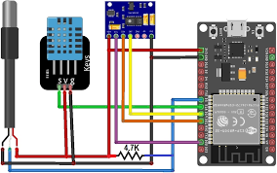
Circuit Diagram

Slide 23
Association
We will use the MAX30100/102 Pulse Oximeter sensor to measure the Heart Rate/Pulse(BPM) as well as the Blood Oxygen Level(SpO2). We will use a DS18B20 Temperature Sensor to measure the temperature of the body. Similarly Patient needs to be placed in a room with a certain temperature and humidity level so that he doesn’t feel uncomfortable. In order to do that we need to monitor the room temperature and humidity as well. So we will be using DHT11 Humidity & Temperature Sensor.This all be monitored through app.If anything goes above the critical values it will send a message to the family members.

Slide 24
Intelligent picking(robotic arm)
Purpose:
This project will identify the object, grasp the object and will move the arm accordingly. This arm will be controlled by the app or google assistant. It will be able to pick up small things like glass of water, medicines, copy book, mobile phone etc.
Future Modifications :-

Slide 25
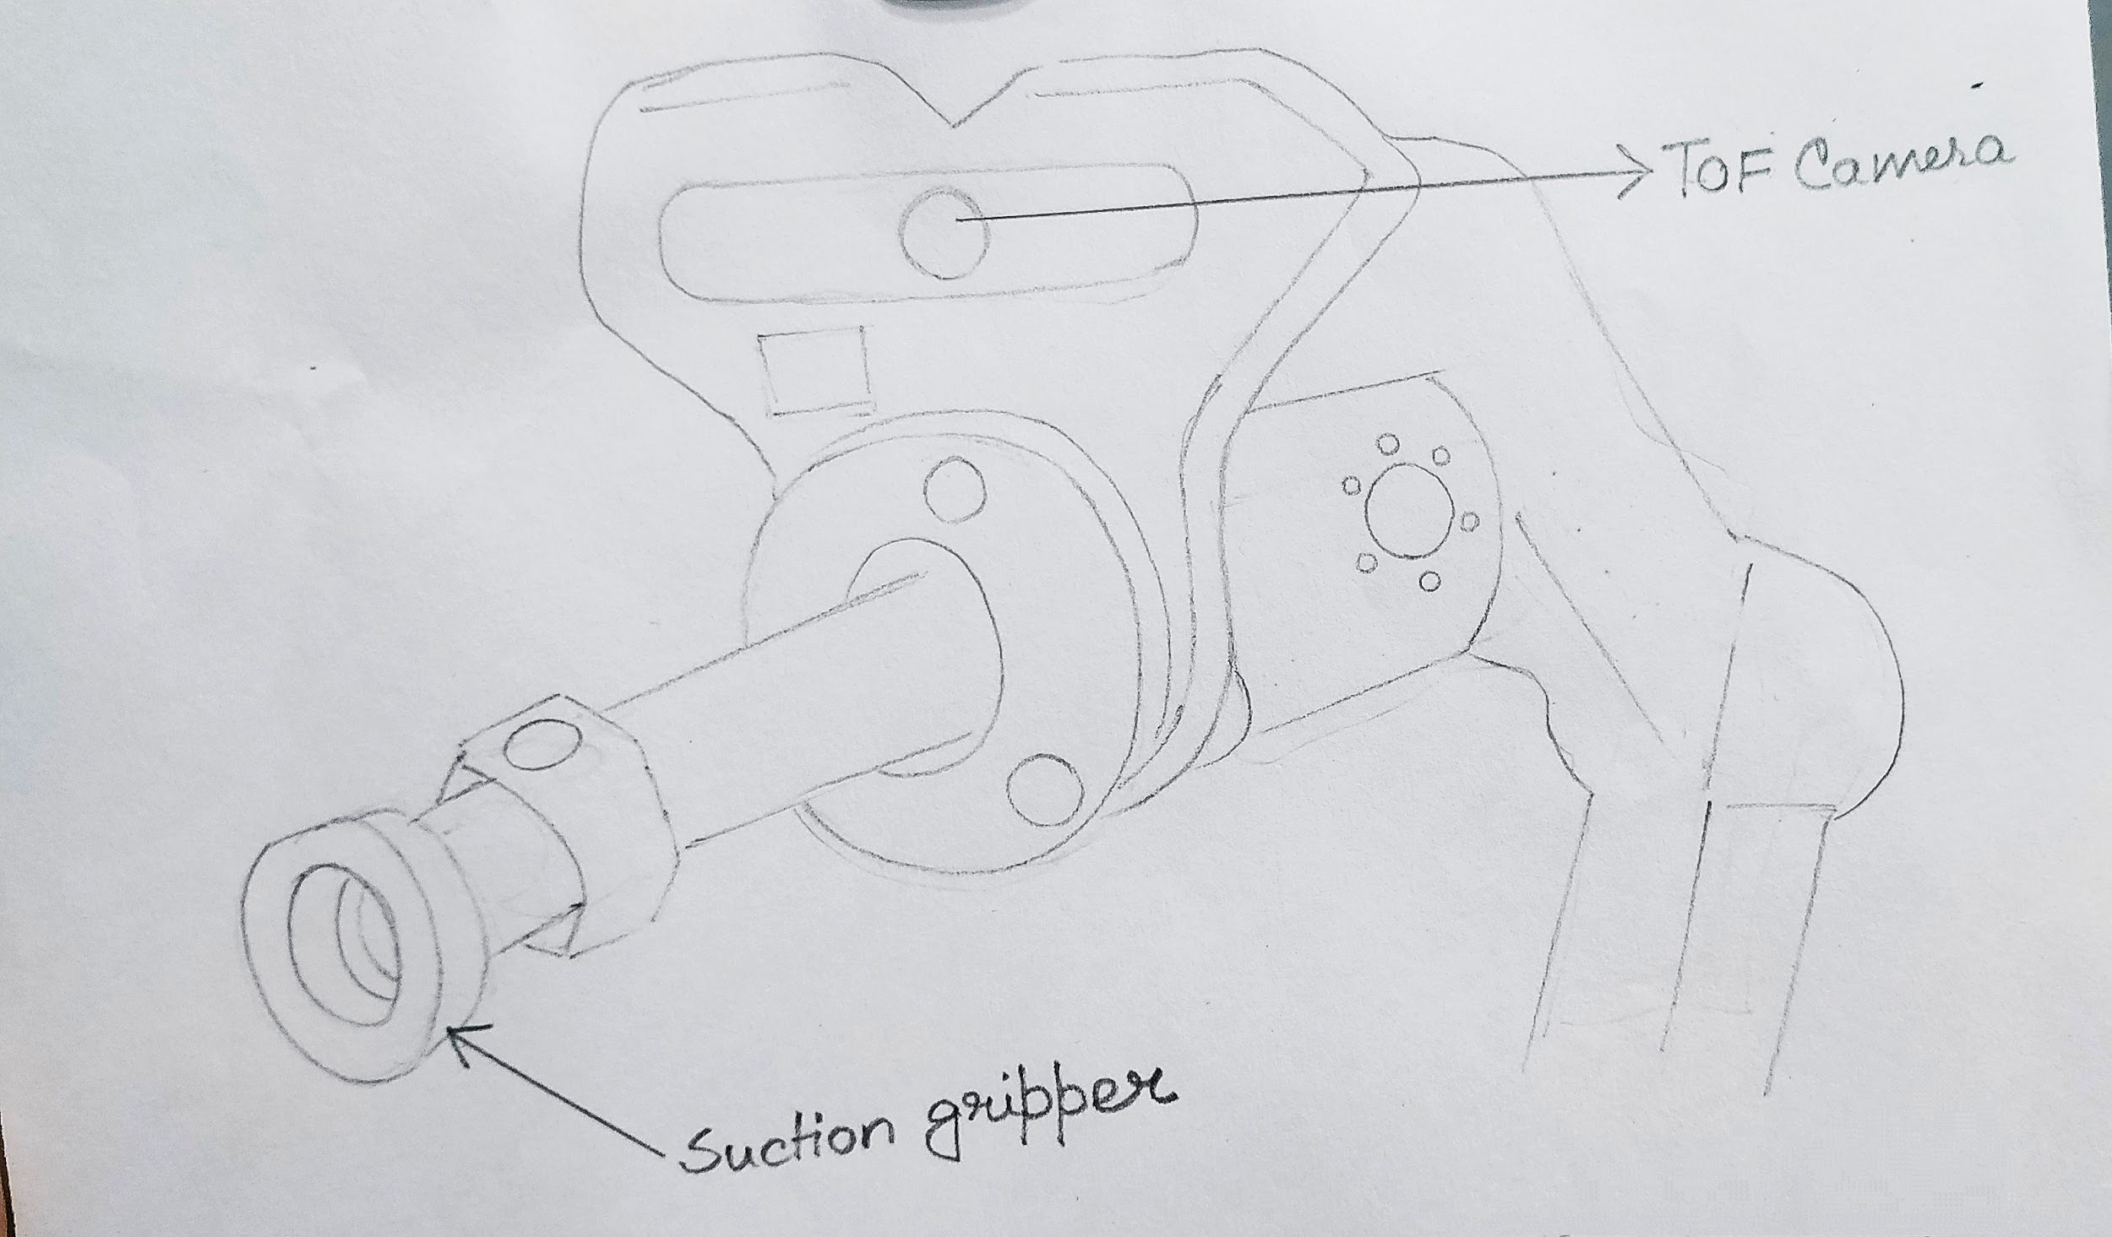
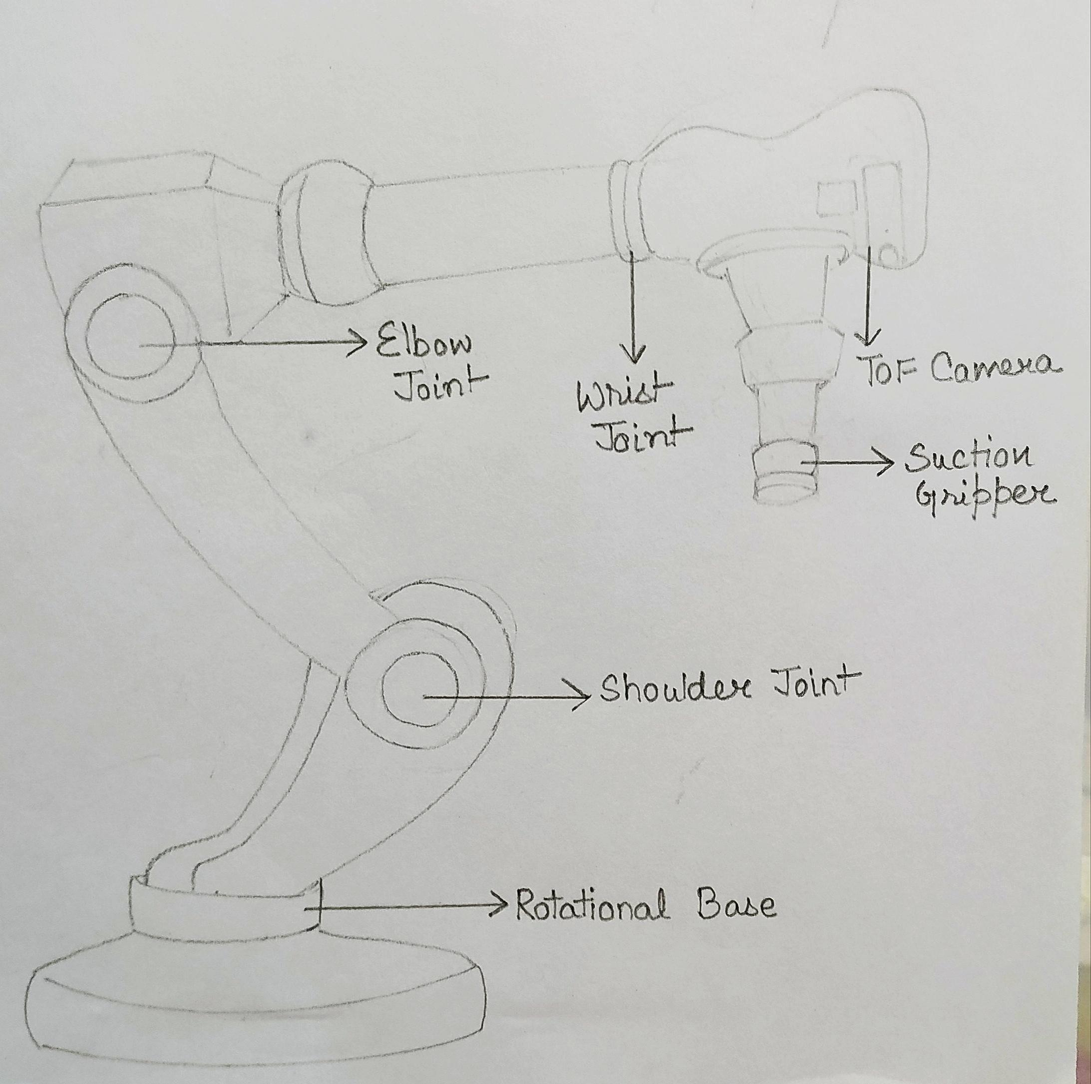
Diagram

Slide 26
Components Required:
TOF camera
Servo motors
ESP32
Robotic arm kit
Battery
IC and diodes
TOF Camera: A TOF camera is a depth mapping tool. “TOF” stands for time of flight. TOF camera systems consist of an image sensor, image processing chip and modulated light source. The camera measures the time it takes for light to travel to and bounce off objects, using the delay to judge distance.
Servo Motor: A servomotor is a rotary actuator or linear actuator that allows for precise control of angular or linear position, velocity and acceleration. It consists of a suitable motor coupled to a sensor for position feedback.

Slide 27
Association:
For example if through google assistant you give a message about picking a glass of water, then the tof camera will detect the glass of water’s distance from the chair and the gripper will come in action,and arm will move accordingly.It will pick the object and will help the person to drink water.You can control motion through app also.

Slide 28
Development of an android app
Software Required:
As we are going to develop an android application, we will need just one software. But to run that software, we will need to install another software first.
Android Studio
JAVA JDK

Slide 29
Association:
We are going to make an application that will have both front-end and back-end coding. On the main screen, it will contain some buttons that will control the switching of the electrical appliances,controlling the robotic arms and checking body temperature, heart rate and even tracking the chair.These are connected to the ESP32 microcontroller board.
For example :-In the back-end coding, We will send a “1” if the switch is on and a “0” if the switch is off.We are going to make a Firebase database. This database will contain 2 entities named as Light and AC. The light will contain the value for the switching of lights and AC will contain a value for the switching of the fan. This value will be then sent to the microcontroller and then the microcontroller will send a control signal to the relay module accordingly.

Slide 30
Future Scope
Obstacle sensors can be added detect hurdles in the path of wheelchair.
In fall detection we can use gsm module to send message on phone number also.
Stepper motor or hydraulic motors can be used to pick larger objects.
By using PIR sensor or camera we can detect unauthorized person near the disabled and alert it through a message.

Slide 31
Reference
https://circuitdigest.com/microcontroller-projects/iot-based-patient-monitoring-system-using-esp8266-and-arduino
https://blog.asksensors.com/iot-cloud-based-gps-tracking-esp32-gps-neo-6m-module/#:~:text=Connect%20the%20GPS%20ground%20pin,computer%20through%20a%20USB%20cable.
https://www.eso.org/public/outreach/eduoff/seaspace/docs/navigation/navgps/navgps-1.html#:~:text=It%20has%20several%20components%2C%20each,geographical%20position%20of%20the%20user.
https://www.hackster.io/gatoninja236/esp32-fall-detector-b8ec6f
https://circuitdigest.com/microcontroller-projects/iot-based-patient-monitoring-system-using-esp8266-and-arduino
https://appuals.com/how-to-make-smart-home-automation-system-using-esp32-module/

